Slide 1
Systems Analysis and Design 10th Edition
Chapter 4
Requirements Modeling

Slide 2
Chapter Objectives
Describe systems analysis phase activities
Explain joint application development (JAD), rapid application development (RAD), and agile methods
Use a functional decomposition diagram (FDD) to model business functions and processes
Describe the Unified Modeling Language (UML) and examples of UML diagrams

Slide 3
Chapter Objectives (Cont.)
List and describe system requirements, including outputs, inputs, processes, performance, and controls
Explain the concept of scalability
Use fact-finding techniques, including interviews, documentation review, observation, questionnaires, sampling, and research
Define total cost of ownership (TCO)
Conduct a successful interview
Develop effective documentation methods to use during systems development

Slide 4
Systems Analysis Phase Overview
Systems Analysis Phase Overview
Understand the proposed project
Ensure that it supports business requirements
Build a solid foundation for system development
Systems Analysis Activities
Requirements Modeling
Data and Process Modeling
Object Modeling
Development Strategies

Slide 5
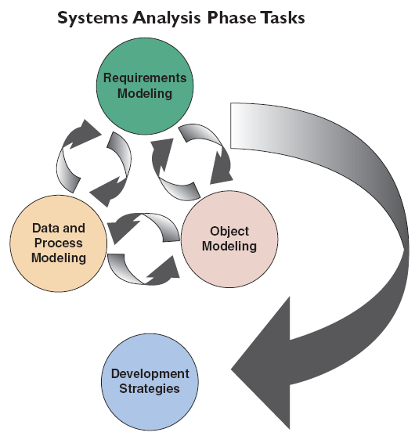
Systems Analysis Phase Overview (Cont.)
Requirements Modeling – Ch 4
Fact-finding to describe the current system
Requirements for new system
Data and Process Modeling – Ch 5
Graphically represent system data and processes
Object Modeling – Ch 6
Create objects to represent things, transactions and events
Development Strategies – Ch 7
Software trends, development alternatives, outsourcing, etc.
FIGURE 4-2 The systems analysis phase consists of requirements modeling, data and process modeling, object modeling, and consideration of development
strategies. Notice that the systems analysis tasks are interactive, even though the waterfall model generally depicts sequential development

Slide 6
Systems Analysis Phase Overview (Cont.)
Systems Analysis Skills
Strong analytical skills
Interpersonal skills
Team-Based Techniques: JAD, RAD, and Agile Methods
Object is to deliver the best possible system at the lowest possible cost in the shortest possible time
Joint application development brings users into the design process
Rapid application development uses a condensed version of the system development life cycle
Agile methods stress intense interaction between developers and users

Slide 7
Systems Requirement Document
A formal written document
Explains why the project is needed
Spells out what the system will do
Forms a basis for the agreement (contract) between you and your customer
Gives checklist for development to follow (a formal list of requirements)

Slide 8
Benefits
Customer can see if needs will be met
Developer can estimate effort involved
Basis for a project plan
Basis for testing application

Slide 9
Do I have to write a Systems Requirement Document
Yes, if any of the following are true:
If project will take longer than a calendar month from idea to production
More than one person is working on the application
More than one person or group will use the application

Slide 10
Joint Application Development
Brings users into the development process as active participants
User Involvement (formally or informally) created a successful system
JAD Participants and Roles
Project leader and one or more members
Participants insulated from distractions of day-to-day operations

Slide 11
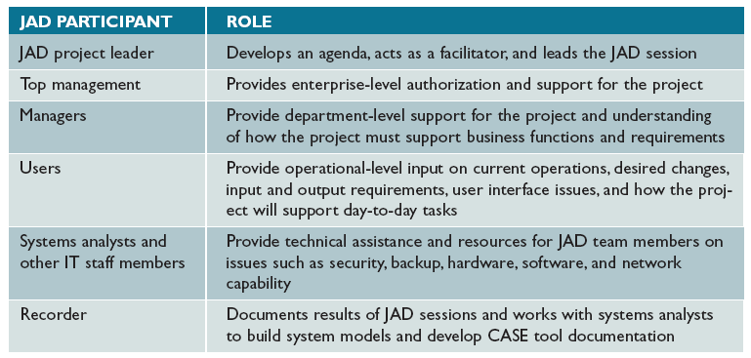
Joint Application Development (Cont.)
FIGURE 4-3 Typical JAD participants and roles

Slide 12
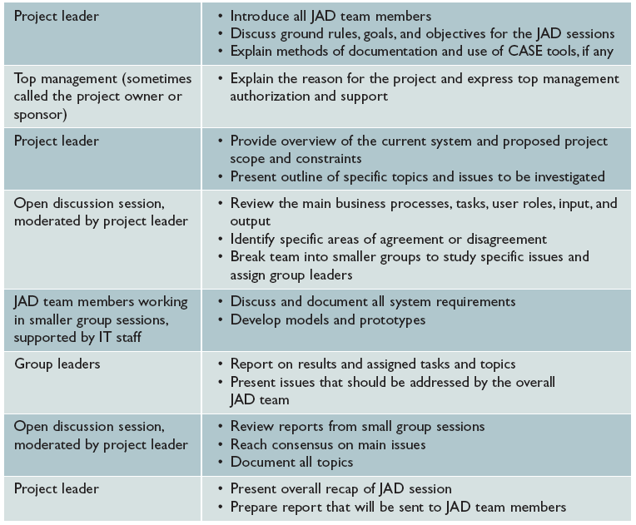
Joint Application Development (Cont.)
FIGURE 4-4 Typical agenda for a JAD session

Slide 13
Joint Application Development (Cont.)
JAD Disadvantages
JAD is more expensive than traditional methods
Can be cumbersome if group is too large
JAD Advantages
JAD allows key users to participate effectively
Users more likely to feel a sense of ownership
Produces a more accurate statement of system requirements

Slide 14
Rapid Application Development
Uses a group approach like JAD
JAD produces a requirements model, RAD produces a new system
Complete methodology
Four-phase life cycle that parallels the traditional SDLC
Reduces cost and development time
Increases the probability of success
Relies on prototyping and user involvement
Prototypes modified based on user input

Slide 15
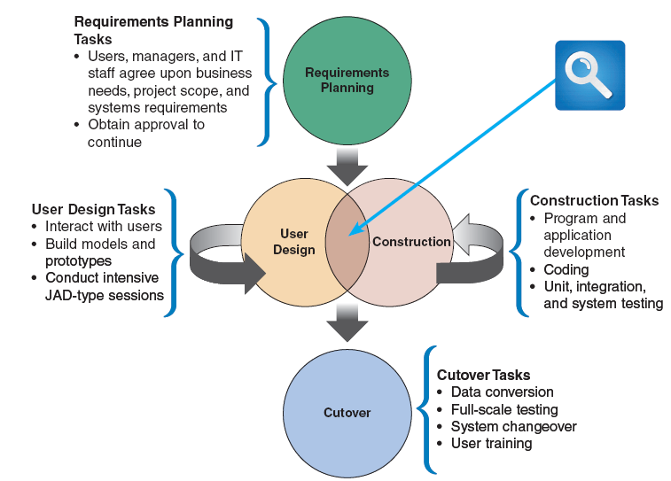
Rapid Application Development (Cont.)
RAD Phases and Activities
FIGURE 4-5 The four phases of the RAD model are requirements planning, user design, construction, and cutover. Notice the continuous interaction between the user design and construction phases

Slide 16
Rapid Application Development (Cont.)
Requirements Planning
Team agrees on business needs, project scope, constraints, and system requirements
Management authorization to continue is obtained
User Design
Users interact with analysts to develop models and prototypes
A combination of JAD and CASE tools are used
Users understand, modify, and approve a working model

Slide 17
Rapid Application Development (Cont.)
Construction
Program and application development
Users can suggest changes as screens or reports are developed
Cutover
Includes data conversion, testing, changeover to the new system, and user training

Slide 18
Rapid Application Development (Cont.)
RAD Objectives
Cut development time and expenses by involving users in every phase of systems development
Allow the development team to make necessary modifications quickly, as the design evolves
RAD Advantages
Systems developed more quickly with significant cost savings
RAD Disadvantages
Does not emphasize strategic business needs (system might work well in short term but miss long-term objectives)
Less time to develop quality, consistency, and design standards

Slide 19
Agile Methods
Agile methods attempt to develop a system incrementally, by building a series of prototypes and constantly adjusting them to user requirements
Developers revise, extend, and merge earlier versions into the final product
Emphasizes continuous feedback, and each incremental step is affected by what was learned in the prior steps

Slide 20
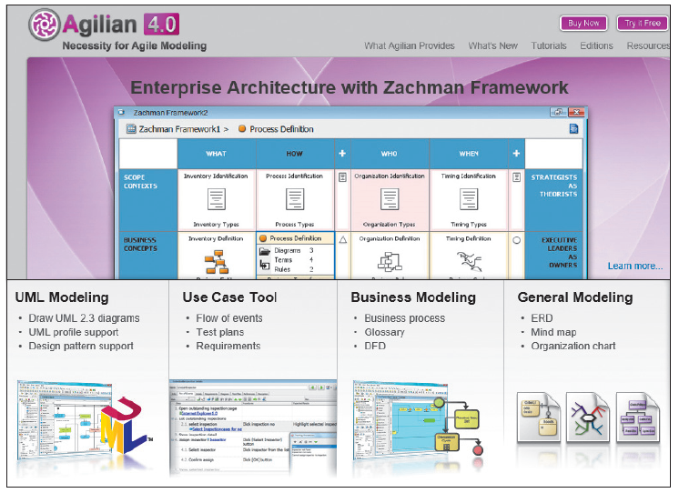
Agile Methods (Cont.)
FIGURE 4-6 Agilian supports various modeling tools, such as the Unified Modeling Language, use cases, and business process modeling, among others

Slide 21
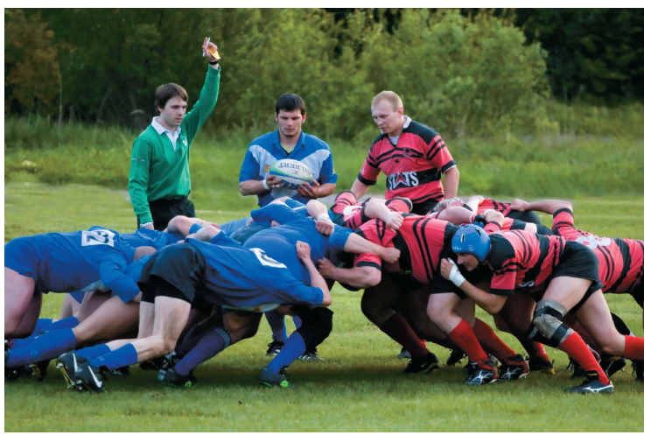
Agile Methods (Cont.)
Scrum
A rugby term
Pigs include the product owner, the facilitator, and the development team
Chickens include users, other stakeholders, and managers
Scrum sessions have specific guidelines that emphasize time blocks, interaction, and team-based activities that result in deliverable software
FIGURE 4-7 In a rugby scrum, team members prepare to lunge at each other to achieve their objectives

Slide 22
Agile Methods (Cont.)
Agile Method Advantages and Disadvantages
Very flexible and efficient in dealing with change
Frequent deliverables constantly validate the project and reduce risk
Team members need a high level of technical and interpersonal skills
May be subject to significant change in scope

Slide 23
Modeling Tools and Techniques
Involves graphical methods and nontechnical language that represent the system at various stages of development
Can use various tools
Functional Decomposition Diagrams
Functional decomposition diagram (FDD)
Model business functions and show how they are organized into lower-level processes

Slide 24
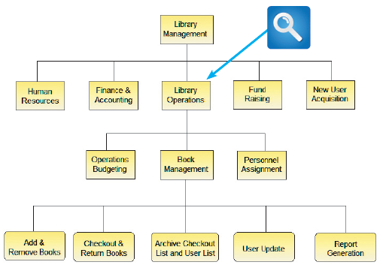
Modeling Tools and Techniques (Cont.)
Functional Decomposition Diagrams
Top-down representation of a function or process
Similar to an organization chart
FIGURE 4-8 This Visible Analyst FDD shows a library system with five top-level functions. The Library Operations
function includes two additional levels of processes and sub processes

Slide 25
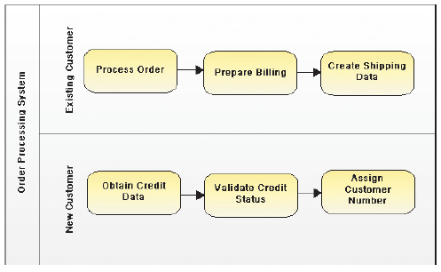
Modeling Tools and Techniques (Cont.)
Business Process Modeling
Business process model (BPM)
Business process modeling notation (BPMN)
Pool
Swim lanes
FIGURE 4-9 Using the Visible Analyst CASE tool, an analyst can create a business process diagram. The overall diagram is called a pool, and the two separate customer areas are called swim lanes

Slide 26
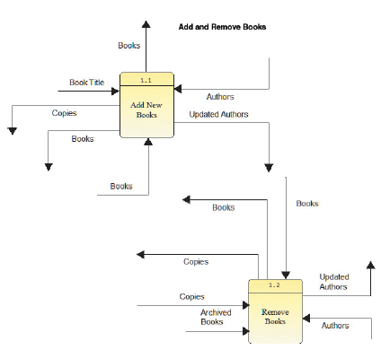
Modeling Tools and Techniques (Cont.)
Data Flow Diagrams
Data flow diagram (DFD)
show how the system stores, processes, and transforms data
Additional levels of information and detail are depicted in other, related DFDs
FIGURE 4-10 This Visible Analyst DFD shows how books
are added and removed in a library system

Slide 27
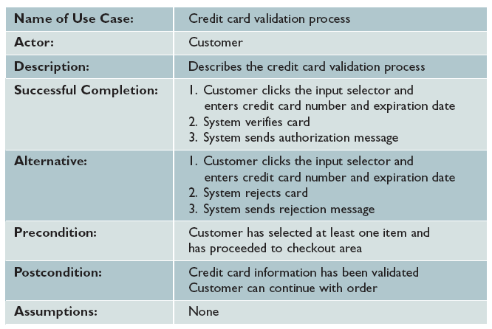
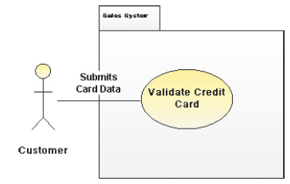
Modeling Tools and Techniques (Cont.)
Use Case Diagrams
Interaction between users and the system
FIGURE 4-12 This table documents the credit card validation use case shown in Figure 4-11
FIGURE 4-11 This Visible Analyst use case diagram shows a sales system, where the actor is a customer and the use case is a credit card validation

Slide 28
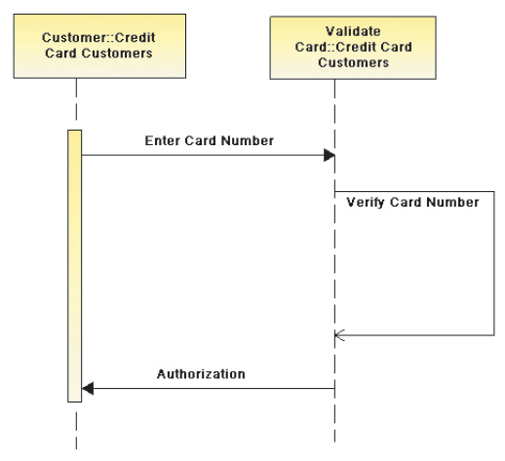
Modeling Tools and Techniques (Cont.)
Sequence Diagrams
Shows the timing of interactions between objects as they occur
FIGURE 4-14 This Visible Analyst sequence diagram shows a credit card validation process

Slide 29
System Requirements Checklist
Output Examples
The Web site must report online volume statistics every four hours, and hourly during peak periods
The inventory system must produce a daily report showing the part number, description, quantity on hand, quantity allocated, quantity available, and unit cost of all sorted by part number
The contact management system must generate a daily reminder list for all sales reps
The purchasing system must provide suppliers with up-to-date specifications

Slide 30
System Requirements Checklist (Cont.)
Input Examples
Manufacturing employees must swipe their ID cards into online data collection terminals that record labor costs and calculate production efficiency
The department head must enter overtime hours on a separate screen
Student grades must be entered on machine-scannable forms prepared by the instructor
Each input form must include date, time, product code, customer number, and quantity
Data entry screens must be uniform, except for background color, which can be changed by the user
A data entry person at the medical group must input patient services into the billing system

Slide 31
System Requirements Checklist (Cont.)
Process Examples
The student records system must calculate the GPA at the end of each semester
As the final step in year-end processing, the payroll system must update employee salaries, bonuses, and benefits and produce tax data required by the IRS
The warehouse distribution system must analyze daily orders and create a routing pattern for delivery trucks that maximizes efficiency and reduces unnecessary mileage
The human resources system must interface properly with the existing payroll system
The equipment rental system must not execute new rental transactions for customers who have overdue accounts
The prescription system must automatically generate an insurance claim form

Slide 32
System Requirements Checklist (Cont.)
Performance Examples
The system must support 25 users online simultaneously
Response time must not exceed four seconds
The system must be operational seven days a week, 365 days a year
The accounts receivable system must prepare customer statements by the third business day of the following month
The student records system must produce class lists within five hours after the end of registration
The online inventory control system must flag all low-stock items within one hour after the quantity falls below a predetermined minimum

Slide 33
System Requirements Checklist (Cont.)
Control Examples
The system must provide logon security at the operating system level and at the application level
An employee record must be added, changed, or deleted only by a member of the human resources department
The system must maintain separate levels of security for users and the system administrator
All transactions must have audit trails
The manager of the sales department must approve orders that exceed a customer’s credit limit
The system must create an error log file that includes the error type, description, and time

Slide 34
Future Growth, Costs, and Benefits
Scalability
A system’s ability to handle increased business volume and transactions in the future
A scalable system offers a better return on the initial investment
To evaluate scalability, you need information about projected future volume for all outputs, inputs, and processes

Slide 35
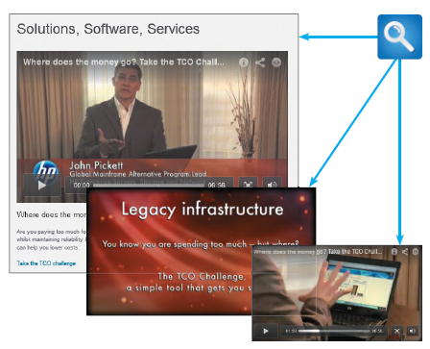
Future Growth, Costs, and Benefits (Cont.)
Total Cost of Ownership
Total cost of ownership (TCO) is especially important if the development team is evaluating several alternatives
One problem is that cost estimates tend to
understate indirect costs
Rapid Economic Justification (REJ)
FIGURE 4-15 HP urges viewers to Take the TCO Challenge. Interested viewers can download a step-by-step TCO analysis that HP created

Slide 36
Fact Finding
Fact-Finding Overview
First, you must identify the information you need
Develop a fact-finding plan
Who, What, Where, When, How, and Why?
Difference between asking what is being done and what could or should be done

Slide 37
Fact Finding (Cont.)
Typical questions to ask
What business functions are supported by the current system?
What strategic objectives and business requirements must be supported by the new system?
What are the benefits and TCO of the proposed system?
What transactions will the system process?
What information do users and managers need from the system?
Must the new system interface with legacy systems?

Slide 38
Fact Finding (Cont.)
Typical questions to ask
What procedures could be eliminated by business process reengineering?
What security issues exist?
What risks are acceptable?
What budget and timetable constraints will affect system development?

Slide 39
Fact Finding (Cont.)
Who, What, Where, When, How, and Why?
Who performs each of the procedures within the system? Why? Are the correct people performing the activity? Could other people perform the tasks more effectively?
What is being done? What procedures are being followed? Why is that process necessary? Often, procedures are followed for many years and no one knows why. You should question why a procedure is being followed at all
Where are operations being performed? Why? Where could they be performed? Could they be performed more efficiently elsewhere?
When is a procedure performed? Why is it being performed at this time? Is this the best time?
How is a procedure performed? Why is it performed in that manner? Could it be performed better, more efficiently, or less expensively in some other manner?

Slide 40
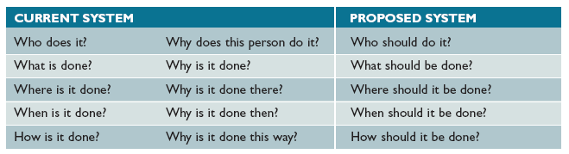
Fact Finding (Cont.)
FIGURE 4-17 Sample questions during requirements modeling as the focus shifts from the current system to the proposed system

Slide 41
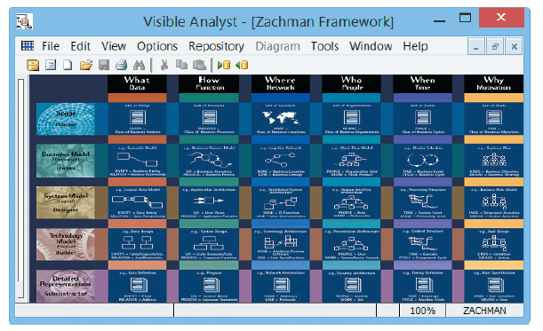
Fact Finding (Cont.)
The Zachman Framework
Zachman Framework for Enterprise Architecture
Helps managers and users understand the model and assures that overall business goals translate into successful IT projects
FIGURE 4-18 Visible Analyst uses the Zachman Framework for Enterprise Architecture. The Zachman concept presents traditional fact-finding questions in a systems development context

Slide 42
Interviews
Step 1. Determine the people to interview
Step 2. Establish objectives for the interview
Step 3. Develop interview questions
Step 4. Prepare for the interview
Step 5. Conduct the interview
Step 6. Document the interview
Step 7. Evaluate the interview

Slide 43
Interviews (Cont.)
Step 1: Determine the people to interview
Select the right people and ask the right questions
Don’t rely on just an organization chart
Decide on group and/or individual interviews
Step 2. Establish objectives for the interview
Determine the areas to be discussed
List the facts you need to gather
Upper management provides the big picture
Users can give you specific details

Slide 44
Interviews (Cont.)
Step 3. Develop interview questions
Decide what to ask and how to phrase the question
The same question to different people - for comparison
Open ended questions encourage spontaneous and unstructured responses
What are users saying about the new system?
How is this task performed?
Close ended questions limit the response - used to verify facts
How many personal computers do you have in this department?
Do you review the reports before they are sent out?
Range of response questions limit the response – uses a scale
On a scale of 1 to 10, with 1 the lowest and 10 the highest, how effective was your training?
How would you rate the severity of the problem: low, medium, or high?

Slide 45
Interviews (Cont.)
Step 4. Prepare for the interview
Careful preparation is essential because an interview is an important meeting and not just a casual chat
Limit the interview to no more than one hour
Verify time, place, length, and topics via e-mail
Ask the interviewee to have samples available

Slide 46
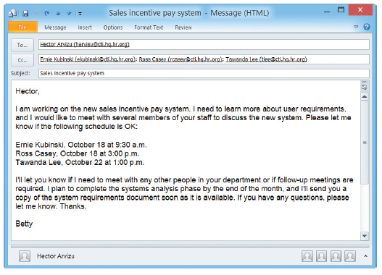
Interviews (Cont.)
FIGURE 4-20 Sample message to a department head about interviews

Slide 47
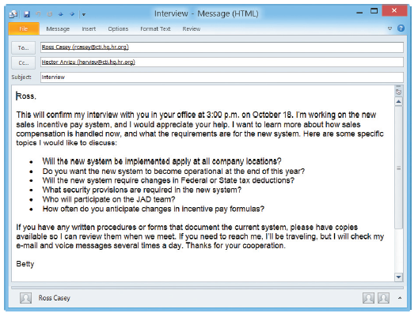
Interviews (Cont.)
FIGURE 4-21 Sample message to confirm an interview

Slide 48
Interviews (Cont.)
Step 5. Conduct the interview
Develop a specific plan for the meeting
Begin by introducing yourself, describing the project, and explaining your interview objectives
Engaged listening
Allow the person enough time to think about the question
After an interview, you should summarize the session and seek a confirmation

Slide 49
Interviews (Cont.)
Step 6. Document the interview
Note taking should be kept to a minimum
After conducting the interview, you must record the information quickly
After the interview, send memo to the interviewee expressing your appreciation
Note date, time, location, purpose of the interview, and the main points you discussed so the interviewee has a written summary and can offer additions or corrections

Slide 50
Interviews (Cont.)
Step 7. Evaluate the interview
In addition to recording the facts obtained in an interview, try to identify any possible biases
Unsuccessful Interviews
No matter how well you prepare for interviews, some are not successful
Misunderstanding or personality conflict could affect the interview negatively, or the interviewee might be afraid that the new system will eliminate or change his or her job

Slide 51
Case Example
FastPak, the nation’s fourth-largest overnight package system, is headquartered in Los Angeles, California.
Jesse Evans is a systems analyst on an IT team that is studying ways to update FastPak’s package tracking system.
Jesse prepared well for her interview with Jason Tanya, FastPak’s executive vice president.
Mr. Tanya did not ask his assistant to hold his calls during the meeting, however. After several interruptions, Jesse tactfully suggested that she could come back another time, or perhaps that Mr. Tanya might ask his assistant to hold his calls. “No way,” he replied. “I’m a very busy man and we’ll just have to fit this in as we can, even if it takes all day.” Jesse was unprepared for his response. What are her options? Is an analyst always in control of this kind of situation? Why or why not?

Slide 52
Other Fact-Finding Techniques
Document Review
Review old and current forms and documentation
Observation
Seeing the system in action gives you additional perspective and a better understanding of the system procedures
Plan your observations in advance
Consider the Hawthorne Effect Study
Productivity seemed to improve whenever workers knew they were being observed

Slide 53
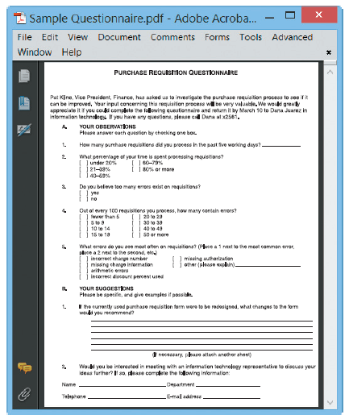
Other Fact-Finding Techniques (Cont.)
Questionnaires and Surveys
When designing a questionnaire, the most important rule of all is to make sure that your questions collect the right data in a form that you can use to further your fact-finding
Fill-in form
FIGURE 4-23 Online version of a sample questionnaire. Does it follow the suggested guidelines?

Slide 54
Other Fact-Finding Techniques (Cont.)
Keep the questionnaire brief and user-friendly
Provide clear instructions that will answer all anticipated questions
Arrange the questions in a logical order, going from simple to more complex topics
Phrase questions to avoid misunderstandings; use simple terms and wording
Try not to lead the response or use questions that give clues to expected answers
Limit the use of open-ended questions that are difficult to tabulate
Limit the use of questions that can raise concerns about job security or other negative issues
Include a section at the end of the questionnaire for general comments
Test the questionnaire whenever possible on a small test group before finalizing it and distributing to a large group

Slide 55
Other Fact-Finding Techniques (Cont.)
Sampling
Systematic sample
Select every tenth customer for review
Stratified sample
Select five customers from each of four postal codes
Random sample
Any 20 customers
Main objective of a sample is to ensure that it represents the overall population accurately

Slide 56
Other Fact-Finding Techniques (Cont.)
Research
Can include the Internet, IT magazines, and books to obtain background information, technical material, and news about industry trends and developments
Site visit

Slide 57
Other Fact-Finding Techniques (Cont.)
Interviews versus Questionnaires
Interview is more familiar and personal
Questionnaire gives many people the opportunity to provide input and suggestions
Brainstorming
Structured brainstorming
Unstructured brainstorming

Slide 58
Documentation
The Need for Recording the Facts
Record information as soon as you obtain it
Use the simplest recording method
Record your findings in such a way that they can be understood by someone else
Organize your documentation so related material is located easily

Slide 59
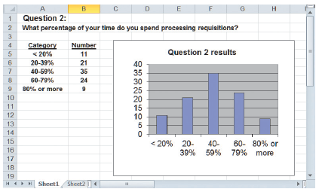
Documentation (Cont.)
Software Tools
CASE Tools
Productivity Software
Word processing
Spreadsheets
Database management
Presentation graphics, and collaborative software programs
Histogram
FIGURE 4-27 This histogram displays the results from Question 2 in the questionnaire shown in
Figure 4-23 on page 156.

Slide 60
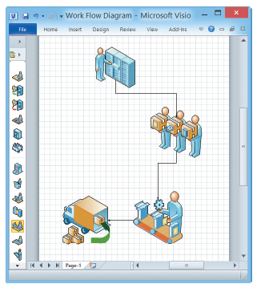
Documentation (Cont.)
Graphic Modeling Software
Produces charts and diagrams
MS Visio popular
FIGURE 4-28 This Visio drawing uses drag-and-drop shapes to represent a business process

Slide 61
Information Management Software
Personal data management software
Microsoft Outlook
A personal calendar
A to-do list with priorities and ability to check off completed items
Microsoft OneNote
Handles many different types of input, including text, handwritten notes, images, audio and video recordings, Web links
OneNote is included in most versions of the Office

Slide 62
Preview of Logical Modeling
At the conclusion of requirements modeling, systems developers should have a clear understanding of business processes and system requirements
The next step is to construct a logical model of the system
IT professionals have differing views about systems development methodologies, and no universally accepted approach exists

Slide 63
Ethics Question
Your supervisor manages the corporate office where you work as a systems analyst. Several weeks ago, after hearing rumors of employee dissatisfaction, he asked you to create a survey for all IT employees. After the responses were returned and tabulated, he was disappointed to learn that many employees assigned low ratings to morale and management policies.
This morning he called you into his office and asked whether you could identify the departments that submitted the lowest ratings. No names were used on the individual survey forms. However, with a little analysis, you probably could identify the departments, because several questions were department-related.

Slide 64
Ethics cont’d
Now you are not sure how to respond. The expectation was that the survey would be anonymous.
Even though no individuals would be identified, would it be ethical to reveal which departments sent in the low ratings?
Why would your supervisor want this information?
Does this violate anonymity?

Slide 65
Chapter Summary
The systems analysis phase includes three activities: requirements modeling, data and process modeling, and consideration of development strategies
The main objective is to understand the proposed project, ensure that it will support business requirements, and build a solid foundation for the systems design phase
Popular team-based approaches include JAD, RAD, and agile methods

Slide 66
Chapter Summary (Cont.)
The fact-finding process includes interviewing, document review, observation, questionnaires, sampling, and research
Systems analysts should carefully record and document factual information as it is collected, and various software tools can help an analyst visualize and describe an information system

